Slide 1
Learning (Modules 21 & 22)
Psych. 101
Fall 2016
Prof: Dr. Doe Buchli, PhD

Slide 2
What is learning?
Changes in behavior as a result of experience.

Slide 3
Learning: Classical and Operant Conditioning
Notes:
Conditioning – reaction to a stimulus modified by learning

Slide 4
Classical Conditioning
Process of learning associations between stimuli and behavioral responses

Slide 5
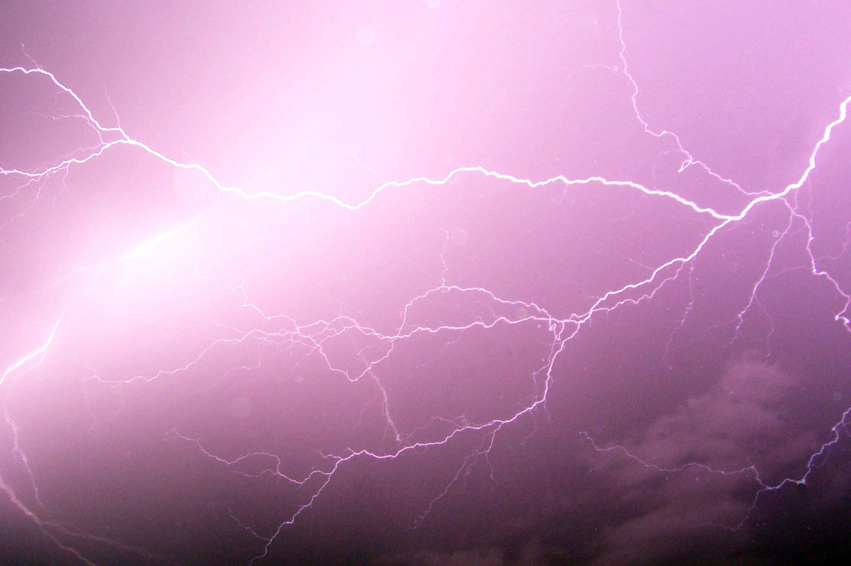
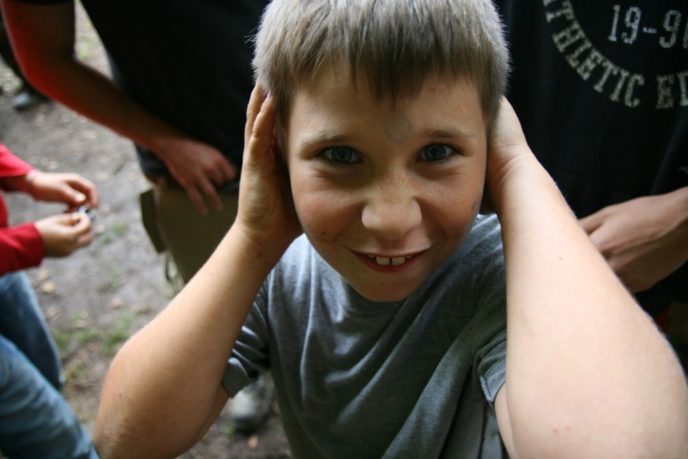
Associative Learning:
Classical Conditioning
Stimulus 1: See lightning
How it works: after repeated exposure to two stimuli occurring in sequence, we associate those stimuli with each other.
Result: our natural response to one stimulus now can be triggered by the new, predictive stimulus.
Stimulus 2: Hear thunder
Here, our response to thunder becomes associated with lightning.
After Repetition
Stimulus: See lightning
Response: Cover ears to avoid sound
Notes:
Instructor: another example of classical conditioning in which we learn from experience occurs when conditioning helps us associate “BEEEP” with an approaching car. The BEEP sound soon is as alarming as the car. Without this learning, cars might run us over.
Another example of classical conditioning: military service personnel who hear a mortar launch sound “thoom” followed by a violent explosion nearby may learn to associate those two stimuli. As a result, at fireworks, even when they know there is no danger, the launch of fireworks sometimes still triggers a “duck and cover” reaction.

Slide 6

Associative Learning:
Classical Conditioning
Stimulus 1: Approaching car
How it works: after repeated exposure to two stimuli occurring in sequence, we associate those stimuli with each other.
Result: our natural response to one stimulus now can be triggered by the new, predictive stimulus.
Stimulus 2: Hear BEEP
Here, our response to a car approaching becomes associated with the sound of a horn honking .
After Repetition
Stimulus: Hear BEEP
Response: Alarmed; step out of the way
Notes:
Click to start animated example (let it play out).
Instructor: another example of classical conditioning in which we learn from experience occurs when conditioning helps us associate “BEEEP” with an approaching car. The BEEP sound soon is as alarming as the car. Without this learning, cars might run us over.
Another example of classical conditioning: military service personnel who hear a mortar launch sound “thoom” followed by a violent explosion nearby may learn to associate those two stimuli. As a result, at fireworks, even when they know there is no danger, the launch of fireworks sometimes still triggers a “duck and cover” reaction.

Slide 7
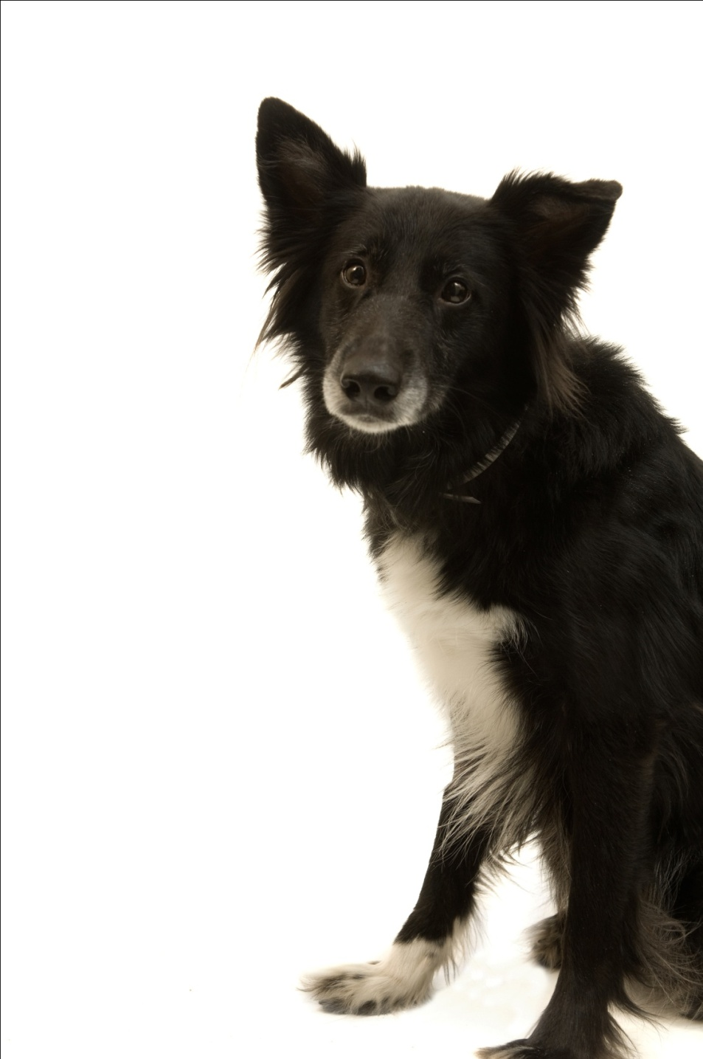
Ivan Pavlov’s Discovery
While studying salivation in dogs, Ivan Pavlov found that salivation from eating food was eventually triggered by what should have been neutral stimuli such as:
just seeing the food.
seeing the dish.
seeing the person who brought the food.
just hearing that person’s footsteps.
Notes:
Click to reveal bullets.
Instructor, you can add verbally:
“The dog had learned that these stimuli predicted the arrival food. These neutral stimuli had become conditioned stimuli.”
Ivan Pavlov then performed controlled experiments yielding much of the knowledge about conditioning still used today.

Slide 8

Before Conditioning
Neutral stimulus:
a stimulus which does not trigger a response
Neutral
stimulus (NS)
No response
Notes:
Click to start animation.

Slide 9
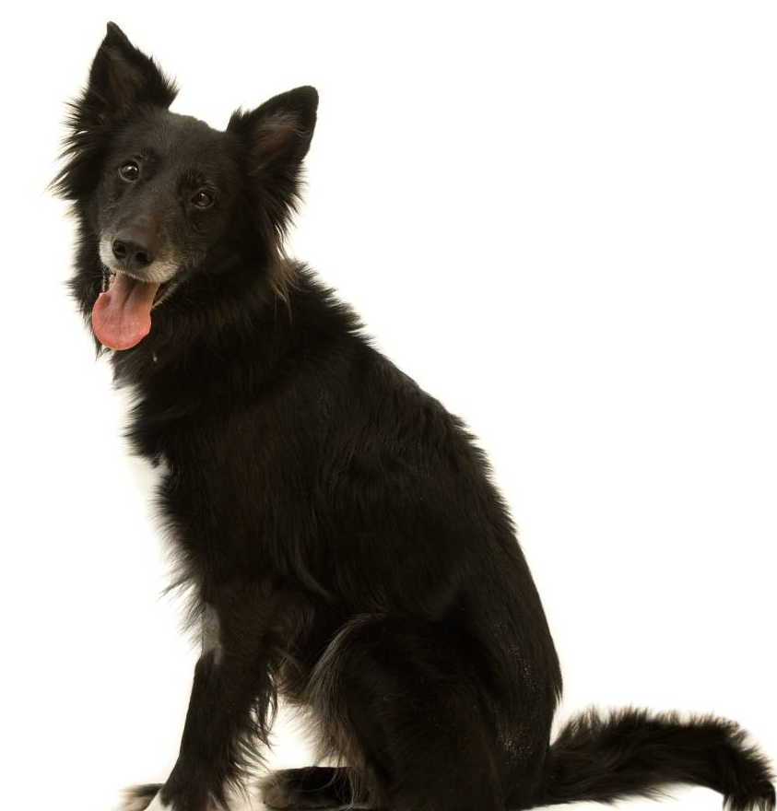
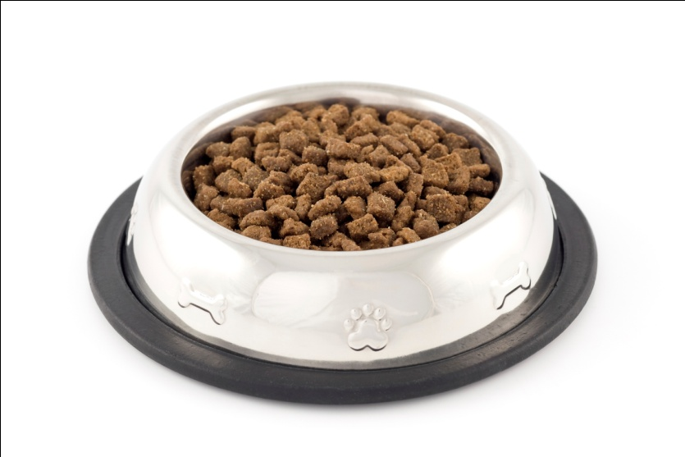
Before Conditioning
Unconditioned stimulus and response:
a stimulus which triggers a response naturally,
before/without any conditioning
Unconditioned response (UR):
dog salivates
Unconditioned
stimulus (US): yummy dog food
Notes:
Click to start animation.
Ivan Pavlov’s dogs exhibited salivation (UR) in response to food (US).

Slide 10
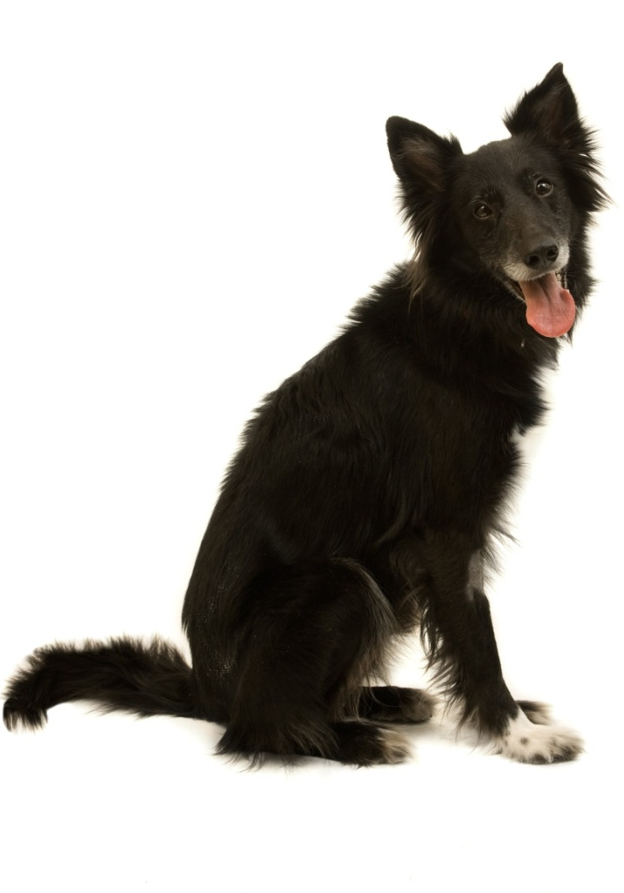

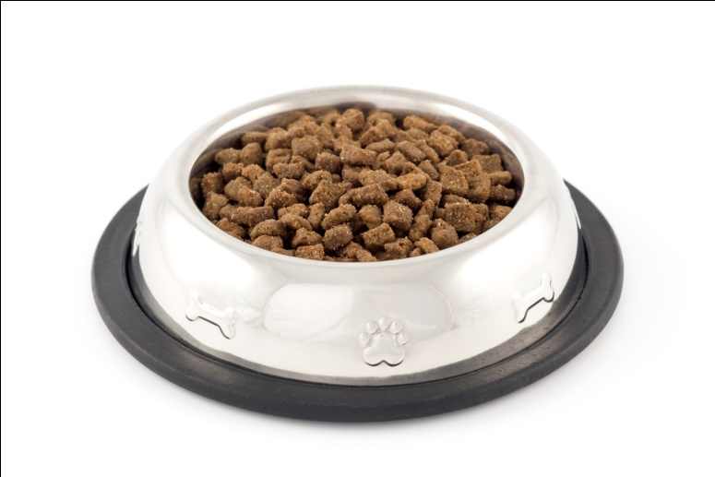
During Conditioning
The bell/tone (N.S.) is repeatedly presented with the food (U.S.).
Neutral
stimulus (NS)
Unconditioned response (UR):
dog salivates
Unconditioned
stimulus (US)
Notes:
Click to start animation.
Ivan Pavlov then presented a tone (NS) just before presenting the food (US).
APA Learning Goal 1: Knowledge Base of Psychology

Slide 11
After Conditioning
The dog begins to salivate upon hearing the tone (neutral stimulus becomes conditioned stimulus).
Conditioned response:
dog salivates
Conditioned (formerly neutral)
stimulus
Notes:
Click to start animation. Click again to show recap.
After a few pairings, the NS (tone) became a CS, and it was able to produce a CR (salivation) by itself.

Slide 12
Key Terms
Unconditioned stimulus (UCS)
Stimulus that elicits an unconditioned response (UCR) without previous conditioning
Unconditioned response (UCR)
Unlearned reaction to an unconditioned stimulus without previous conditioning
Examples
Food (UCS) → Salivation (UCR)
Thunder (UCS) → Covering ears (UCR)
Approaching car (UCS) → Getting out of the way (UCR)

Slide 13
Key Terms
Neutral stimulus
Stimulus that, before conditioning, does not naturally bring about the response of interest
Conditioned stimulus (CS)
Previously neutral stimulus that, through repeated pairings with an unconditioned stimulus (UCS), now after conditioning elicits a conditioned response
Conditioned response (CR)
Learned reaction to a conditioned stimulus that occurs because of repeated pairings with a unconditioned stimulus
Examples
Bell (CS) + Food (UCS) = Salivation (CR)
Lightning (CS) + Thunder (UCS) = Covering ears (CR)
BEEP!! (CS) + Approaching car (UCS) = Getting out of the way (CR)

Slide 14

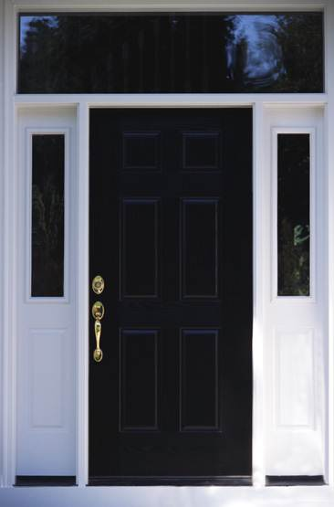

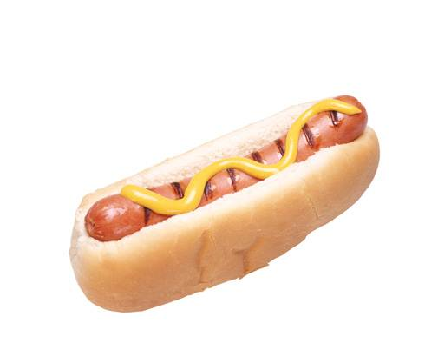
Find the US, UR, NS, CS, CR in the following:
Your romantic partner always uses the same shampoo. Soon, the smell of that shampoo makes you feel happy.
The door to your house squeaks loudly when you open it. Soon, your dog begins wagging its tail when the door squeaks.
The nurse says, “This won’t hurt a bit,” just before stabbing you with a needle. The next time you hear “This won’t hurt,” you cringe in fear.
You have a meal at a fast food restaurant that causes food poisoning. The next time you see a sign for that restaurant, you feel nauseated.
Notes:
1
Neutral Stimulus – Shampoo
Unconditioned Stimulus – Partner
Unconditioned Response – Happy emotions
Conditioned Stimulus – Shampoo
Conditioned Response – Happiness
2
Neutral Stimulus – Door Squeaks
Unconditioned Stimulus – People
Unconditioned Response – Wag Tail
Conditioned Stimulus – Door Squeaks
Conditioned Response – Wag Tail
3
Neutral Stimulus – null
Unconditioned Stimulus – Needle
Unconditioned Response – Fear to the needle
Conditioned Stimulus – Nurse Talking
Conditioned Response – Fear
4
Neutral Stimulus – Restaurant
Unconditioned Stimulus – Meal
Unconditioned Response – Hunger
Conditioned Stimulus – Restaurant sign
Conditioned Response – Nausea

Slide 15
Taste Aversion: The Garcia Effect
John Garcia introduced a novel substance (sweetened water) to rats after they were given either mild or moderate radiation to induce sickness, or no radiation
When presented with the opportunity to drink the sweetened water again, rats in the radiation conditions drank significantly less than rats in the control condition
Noteworthy findings because:
Occurred after just one trial of learning
Persisted after a long delay
Specific to food/drink
Theory: conditioned taste inversion is an adaptive survival mechanism

Slide 16
Taste Aversion: The Garcia Effect
Highly selective
If rats got sick after drinking sweet water in a cage illuminated by a red light, they avoided the water but not the red light
If they got shocked after drinking the water, they avoided the environment but not the water

Slide 17
Taste Aversion: The Garcia Effect
Neutral stimulus: Sweetened water
Unconditioned stimulus: radiation
Unconditioned response: vomiting/nausea
Conditioned stimulus: Sweetened water
Conditioned response: vomiting/nausea

Slide 18
Acquisition
Acquisition refers to the initial stage of learning/conditioning.
What gets “acquired”?
→ The association between a neutral stimulus (NS) and an unconditioned stimulus (US).
How can we tell that acquisition has occurred?
→ The UR now gets triggered by a CS
(drooling now gets triggered by a bell).
Timing
For the association to be acquired,
the neutral stimulus (NS) needs to repeatedly appear before the unconditioned stimulus (US)…about a half-second before, in most cases. The bell must come right before the food.
Notes:
Instructor, some discussion prompts:
“In the “acquisition graph,” what does “strength” mean?” [Answer: it refers to the strength of the association between NS and US, as measured by the likelihood and intensity of the unconditioned response (drooling) now being triggered by the former neutral (now conditioned) stimulus (the bell). More drooling = more strength.
Timing issue: why wouldn’t it work if we rang the bell AFTER presenting the food?...because our bodies/brains are not set up to work that way. Why not?...conditioning allows us to prepare for benefits or threats; a bell after the food wouldn’t predict anything..
An exception to the half-second rule is food aversion, coming up in a later slide.

Slide 19
Acquisition and Extinction
Extinction refers to the diminishing of a conditioned response. If the US (food) stops appearing with the CS (bell), the CR decreases.
Why?
Notes:
Answer: the bell no longer predicts the arrival of food.

Slide 20
Spontaneous Recovery [Return of the CR]
After a CR (salivation) has been conditioned and then extinguished:
following a rest period, presenting the tone alone might lead to a spontaneous recovery (a return of the conditioned response despite a lack of further conditioning).
if the CS (tone) is again presented repeatedly without the US, the CR becomes extinct again.
Notes:
Instructor: one implication of spontaneous recovery is that a behavior therapist may think that a phobic reaction has been extinguished, by repeatedly presenting the phobic stimulus without anything bad happening. However, after a rest from treatment, the phobic reaction can return. One solution is counterconditioning in order to build a new association.
The memory is still there, but since the response is not there anymore due to the CS, the organism decides not to have a CR

Slide 21
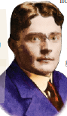
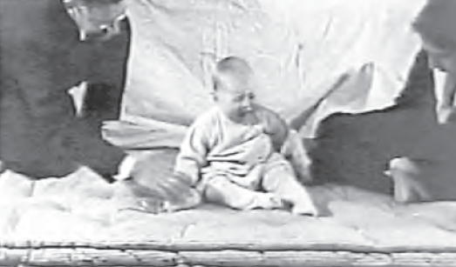
John B. Watson and Classical Conditioning: Playing with Fear
In 1920, 9-month-old Little Albert was not afraid of rats.
John B. Watson and Rosalie Rayner then clanged a steel bar every time a rat was presented to Albert.
Albert acquired a fear of rats, and generalized this fear to other soft and furry things.
Watson prided himself in his ability to shape people’s emotions. He later went into advertising.
Notes:
Click to reveal bullets.
A different application of classical conditioning would include working with phobias; not just creating them, but eliminating them.
Exposure to a conditioned stimulus (such as a store where panic attacks have occurred) without UR (the panic attack) can extinguish phobias, but to prevent spontaneous recovery, counterconditioning must occur (associating the store with a relaxed state).

Slide 22
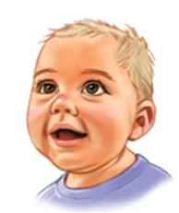
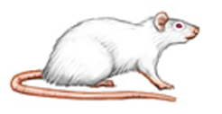
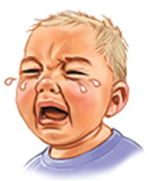
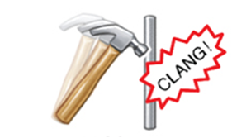
Little Albert Experiment
Before Conditioning
No fear
NS: rat
UCS: steel bar hit with hammer
Natural reflex:
fear

Slide 23
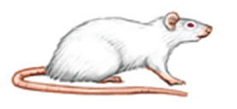
Little Albert Experiment
UCS: steel bar hit with hammer
NS: rat
Natural reflex:
fear
During Conditioning

Slide 24
Little Albert Experiment
NS: rat
Conditioned reflex:
fear
After Conditioning

Slide 25
Operant Conditioning
Process of learning the association between a behavioral response and an outcome

Slide 26
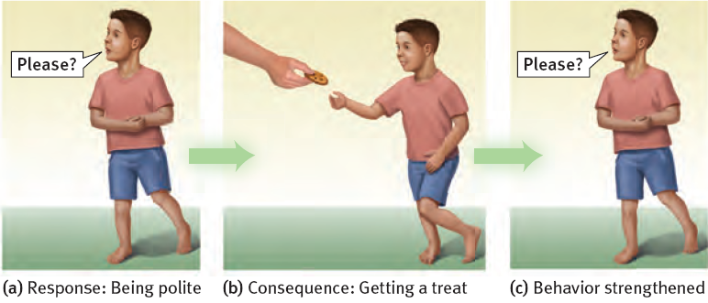
Associative Learning: Operant Conditioning
Child associates his “response” (behavior) with consequences.
Child learns to repeat behaviors (saying “please”) which were followed by desirable results (cookie).
Child learns to avoid behaviors (yelling “gimme!”) which were followed by undesirable results (scolding or loss of dessert).

Slide 27
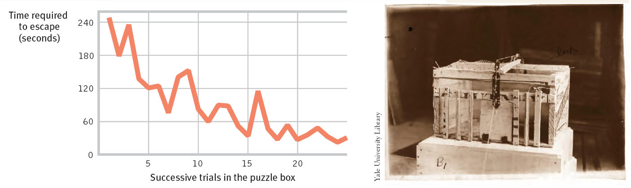

Thorndike’s Law of Effect
Edward Thorndike placed cats in a puzzle box; they were rewarded with food (and freedom) when they solved the puzzle.
Thorndike noted that the cats took less time to escape after repeated trials and rewards.
The law of effect states that behaviors followed by favorable consequences become more likely, and behaviors followed by unfavorable consequences become less likely.
Notes:
More details on Edward Thorndike’s experiment: the cats did not learn from observing a solution, but did learn from trials with rewards.
The word “strengthened” is used in this definition to apply to all the effects of rewarding a behavior including making it happen more frequently, more intensely, or in the case of the cats, more time-efficiently.
A more thorough statement of Thorndike’s view is that when a behavior (or “a response”, as Thorndike might have called the cat’s behavior) produces a desirable effect in a particular situation, the behavior will become more likely to occur again in that situation, AND, a behavior that produces an undesired effect becomes less likely to occur again in that situation.

Slide 28
Kitties

Slide 29
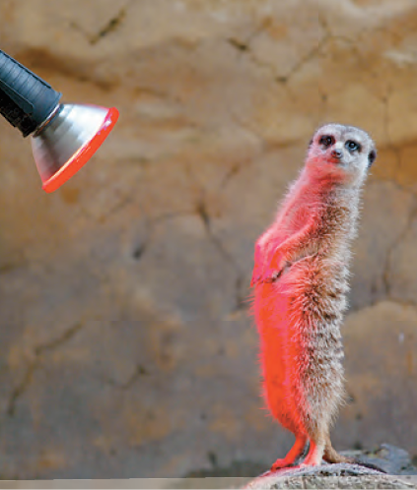
Reinforcement
Reinforcement refers to any feedback from the environment that makes a behavior more likely to recur.
Positive (adding) reinforcement: adding something desirable (e.g., warmth)
Negative (taking away) reinforcement: ending something unpleasant (e.g., the cold)
This meerkat has just completed a task out in the cold
For the meerkat, this warm light is desirable.

Slide 30
Operant Effect: Punishment
Punishments have the opposite effects of reinforcement. These consequences make the target behavior less likely to occur in the future.
+ Positive Punishment
You ADD something unpleasant/aversive (ex: spank the child)
- Negative Punishment
You TAKE AWAY something pleasant/ desired (ex: no TV time, no attention)--MINUS is the “negative” here
→Positive does not mean “good” or “desirable” and negative does not mean “bad” or “undesirable.”

Slide 31

Shaping Behavior Reinforcing Successive Approximations
When a creature is not likely to randomly perform exactly the behavior you are trying to teach, you can reward any behavior that comes close to the desired behavior.
Students could smile and nod more when the instructor moves left, until the instructor stays pinned to the left wall.
Notes:
Instructor: the “shape the instructor” exercise carries a myth that it was done in one class until the professor went out the door.
In a more realistic example, animal training makes use of shaping by rewarding successive approximations. (an illustration with seals occurs elsewhere in this slide show). A seal may not naturally balance a ball on its nose for a long time, but it might nudge it up into the air. By rewarding this behavior, the behavior can get stronger and more prolonged and can be rewarded when done after a hand gesture so that the gesture can serve as a command.

Slide 32
Raties

Slide 33
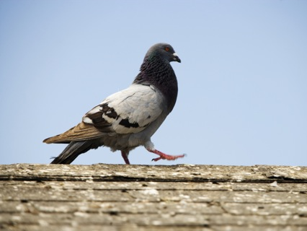
How often should we reinforce?
Do we need to give a reward every single time? Or is that even best?
B.F. Skinner experimented with the effects of giving reinforcements in different patterns or “schedules” to determine what worked best to establish and maintain a target behavior.
In continuous reinforcement (giving a reward after the target every single time), the subject acquires the desired behavior quickly.
In partial/intermittent reinforcement (giving rewards part of the time), the target behavior takes longer to be acquired/established but persists longer without reward.
Notes:
A pigeon given a reward sometimes for pecking a key, later pecked 150,000 times without getting a reward. Trying to think like this pigeon: if the reward sometimes comes even after not showing up for a while, maybe the 150,001st time will be the time I get the reward.
Perhaps this is why neglected kids hold out hope of parental love and keep trying for it even after years without a response; maybe on some rare occasion, there was an apparently loving moment.

Slide 34
Different Schedules of Partial/Intermittent Reinforcement
We may schedule our reinforcements based on an interval of time that has gone by.
Fixed interval schedule: reward every hour
Variable interval schedule: reward after a changing/random amount of time passes
We may plan for a certain ratio of rewards per number of instances of the desired behavior.
Fixed ratio schedule: reward every five targeted behaviors
Variable ratio schedule: reward after a randomly chosen instance of the target behavior
Notes:
Examples of each of the above:
Fixed interval schedule--paid once a week
Variable interval schedule--patted on the back occasionally
Fixed ratio schedule--paid for every 10 units of work completed
Variable ratio schedule--unpredictably getting a “good job” comment about some unit of work you completed

Slide 35
Which Schedule of Reinforcement is This? Ratio or Interval? Fixed or Variable?
Rat gets food every third time it presses the lever
Getting paid weekly no matter how much work is done
Getting paid for every ten boxes you make
Hitting a jackpot sometimes on the slot machine
Winning sometimes on the lottery you play once a day
Checking cell phone all day; sometimes getting a text
Buy eight pizzas, get the next one free
Fundraiser averages one donation for every eight houses visited
Kid has tantrum, parents sometimes give in
Repeatedly checking mail until paycheck arrives
FR
FI
FR
VR
VI/VR
VI
FR
VR
VR
FI
Notes:
Instructor: on the first few items, or for students who may struggle, you could call on people to simply state whether it’s ratio or interval, or whether it’s fixed or variable. However, after #5, ask for answers stating the whole term such as “fixed interval.”
Explanations for selected items:
#5. If you play once a day, then the ratio (percentage of behaviors rewarded) and the interval (percentage of days rewarded) are the same, so both answers are correct.
#6. The reward for checking for messages is a function of time, not a function of how often you check. This goes for #10 as well, but paychecks are on a fixed interval, while text messages come in variable intervals.
#8. The word “average” is crucial: donations can vary tremendously, so the average is no guarantee of a fixed ratio of donations every eighth house.

Slide 36
Classical vs. Operant Conditioning
Both forms of associative learning, however:
Acquisition
In classical conditioning, the learner associates a particular stimulus with a contextually appropriate response. In operant conditioning, the learner associates a response with an outcome or consequence that occurs as a direct result of that response.
Sequence
In classical conditioning, the learner’s response comes after the critical event (the CS). In operant conditioning, the learner’s response comes before the critical event (the outcome or consequence).
Control
Classical conditioning is very passive. The learner responds to events that are happening that he/she has no control over. Operant conditioning is very active. The learning exerts control over the environment by responding in a way that elicits the most favorable consequence.

Slide 37
Differences Between Operant and Classical Conditioning
What gets acquired?
Classical: US—CS, CS—CR
Operant: Response – Outcome (reinforcement or punishment)
How much control does the organism exert over environment?
Classical: None. Very passive. Simply responding to a series of events and making the most contextually appropriate response.
Operant: A lot. Learner controls his environment by making best response (avoid, punishment, get reinforcement)

Slide 38
Differences Between Operant and Classical Conditioning
Sequence: when does the critical event happen?
Classical: critical event = CS; happens before the response
Operant: critical event = consequence; happens after the response

Slide 39
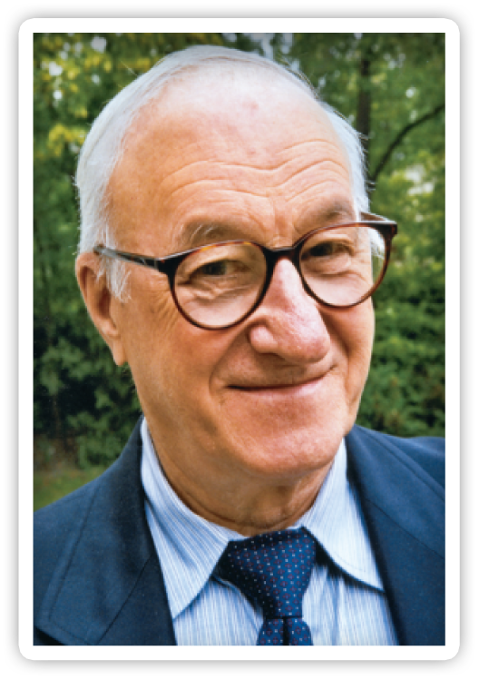
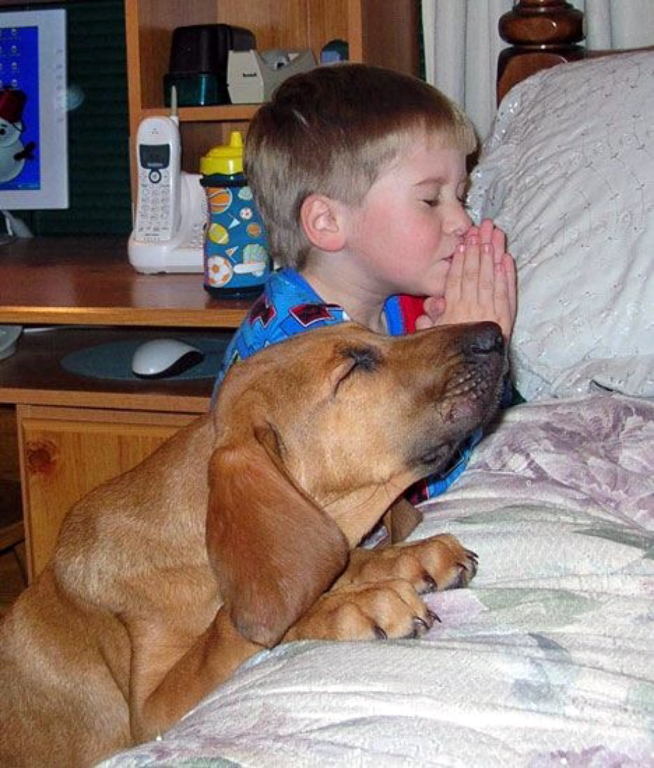

Observational Learning
Albert Bandura
Notes:
We’ve been talking about learning…Is all of learning explained through classical and operant conditioning?
Imagine the first time you did laundry…did you simply start trying random things until you got a favorable response (clean clothes). If you did, you’d still be learning to wash clothes. Of course you didn’t, you knew exactly where to put the clothes. Your textbook uses the example of driving a car. When you first learned to drive a car did you do random things until the car started? Of course not, you knew exactly where to put the key for example. How did you learn that?
Observation.
Observational learning occurs when an organism’s responding is influenced by the observation of others. The others that we observe—we call them models.
Albert Bandura identified four key processes in observational learning: attention, retention, reproduction, and motivation. Let’s take each in turn. According to Bandura—classical and operant conditioning can take place vicariously. If the observed response is rewarded it is strengthened for the model and the observer. The bobo doll study

Slide 40
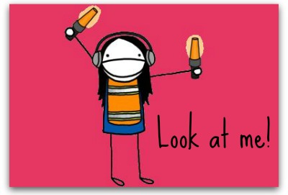
Attention
First,…you must be paying attention to the models behavior (and the consequences of that behavior).
Notes:
Now—we can talk about cognition in learning…remember our discussion of learning to date has been from the perspective of the behaviorist and they are only concerned with observable behavior.

Slide 41
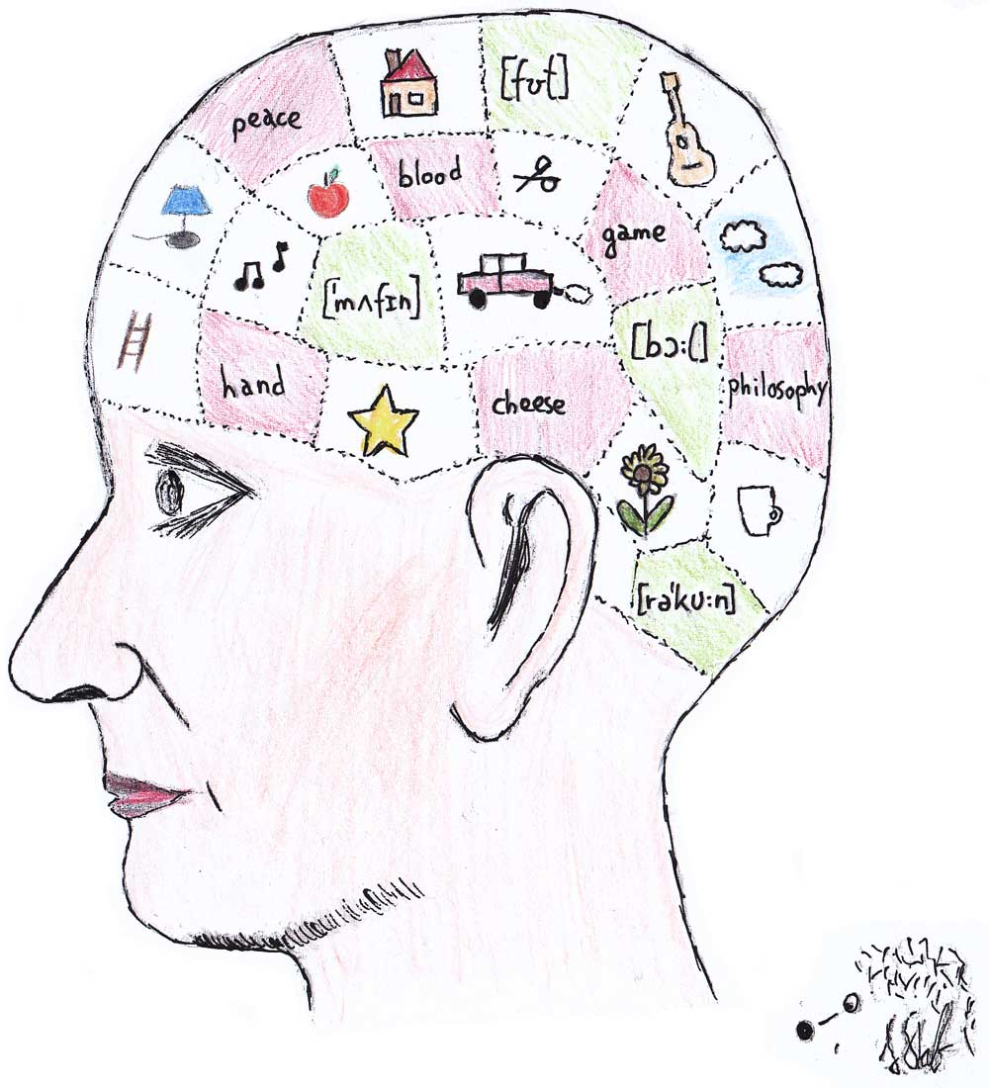
Retention
Next, …you have to remember what you saw. You must be able to create and store a mental representation in your memory.

Slide 42
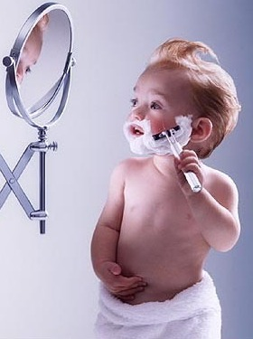
Reproduction
Access the mental representation and change it into overt behavior.
Reproduction is easier for some behaviors more than others.
For example, few of us can execute a flawless back handspring simply from years of watching the Olympics.

Slide 43
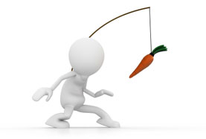
Motivation
Now, you must encounter a situation in which you believe your response will be rewarded.

Slide 44
The Bobo Doll Studies
Study 1: live models playing roughly with an inflatable clown.
Study 2: filmed models playing roughly with inflatable clown.
Study 3: filmed models and changed the consequences that the model received (reinforcement or punishment).
Notes:
Physical punishment can increase aggressive behavior in children. Parents may unknowingly serve as models for aggressive behavior. Individuals displaying violence on television may also serve as a model of aggressive behavior for children.
Click the link [the bobo doll studies] to show you tube of bobo doll study. Stop video right before mention of empathy.
Web link also pasted below.
https://www.youtube.com/watch?v=zerCK0lRjp8
Cathodic? – so when you watch it, you need to act it out yourself

Slide 45
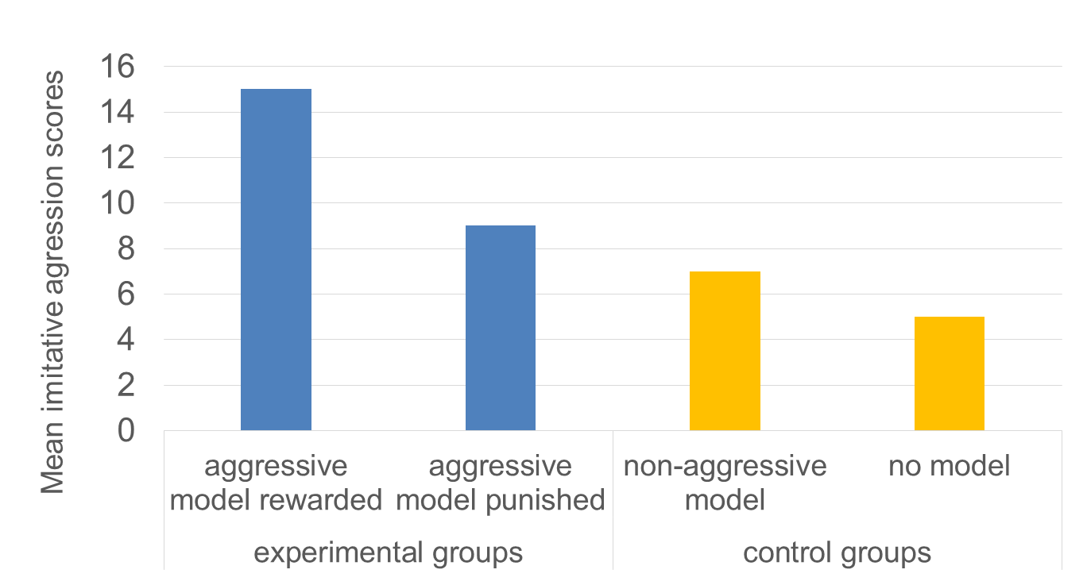
Mean Imitative Aggression Scores for Children
Notes:
Children in this study were about 4 years old on average.
While children were at daycare, they were invited to play in a toy room. The child was then told that the escort needed to stop in their office briefly—this was part of the experimental manipulation. Manipulation: the child was told to watch TV during the delay: on the TV was a 5 minute film sequences:
Aggression-rewarded—Rocky attacks Johnny, then gets to play with his toys and have soda and cookies.
Aggression-punished—Johnny fights back, Rocky is afraid.
No aggression—Rocky and Johnny engaged in vigorous play.
No model: the child does not watch TV
Then child is taken to the toy room—bobo dolls included (also options for non-aggressive play). Researchers counted the number of aggressive acts in 20 minutes.
[Review results on the graph.]

Slide 46
Media Violence & Aggression
Exposure to media violence increases the likelihood of physical and verbal aggression, aggressive thoughts, and aggressive emotions.
A problem of desensitization…muted reaction to real violence (e.g., Carnagey et al., 2007 found decreased reaction to violence after playing violent video games).
“Numbing effect”…individuals who played violent games were less likely to help an “injured victim.” (Bushman & Anderson, 2009)
Notes:
This is true for children and adults.
Randomly assigned to play violent vs. nonviolent video games for 20 minutes. Smaller physiological reactions to video recordings of prison fights, police confrontations, etc.) for those who played violent games compared to those who played nonviolent video games.
Participants in Bushman & Anderson, 2009 played violent or nonviolent video games in the lab—afterwards they heard a staged fight where one person was clearly injured and the aggressor had already fled the scene. Those who played the violent video game took longer to help (73 seconds vs. 16 seconds).

Slide 47
Genetic predisposition to aggressiveness
High Exposure to Media Violence
High Aggressiveness
Notes:
There have been a number of correlational studies to try to understand what happens in real life.
The more violence children watch—the more aggressive they tend to be. But correlation does not equal causation.
Critics say:
Maybe children who are already aggressive are more interested in violent TV shows.
Longitudinal studies (following people over time) have shown that high exposure to violence in childhood predicts aggressiveness in adolescence and adulthood. The effect of media and TV violence may be small, but even if only 1 in 100 viewers became more aggressive that could have a big impact given that television reaches millions of people.

